Slide 1

Banking
Dashboard
Power BI

Slide 2

ABOUT THE PROJECT
The project is a banking project where we have used a banking dataset. Here in this dashboard we are going to show features like Loan analysis and Deposit Analysis and summary of the overall dataset.

Slide 3



Total Clients
188
Total Engagement Account
$18.26K
Total CC Account
$135
Some important KPI’s

Slide 4


Financial Goals
Total Loan
$139.9M
Total Deposit
$111.49M
Total Fees
$5.17M

Slide 5
Bank Numbers
$60.18M
$55.5M
$83.52M
Bank Loan
Bank Deposit
Business Lending

Slide 6
FOREIGN CURRENCY AMOUNT
$ 2.71 M
FOREIGN CURRENCY AMOUNT

Slide 7
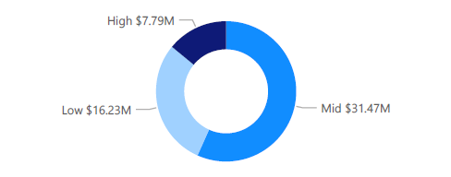
Bank Loan by Income band
What we observe?
Bank loan is highest for Mid Income band and lowest for High Income band.

Slide 8
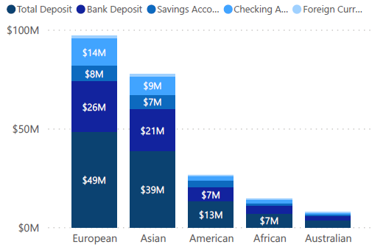
Bank Loan by Income band
What we observe?
Highest features are in the European countries followed by Asian Countries.
Lowest features are in Australian countries followed by African countries.

Slide 9
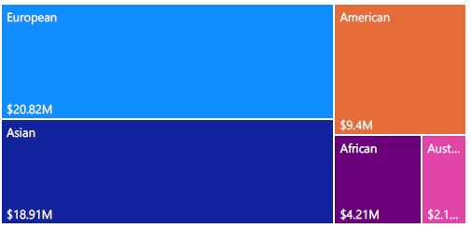
Bank Loan by Nationality
What we observe?
Bank loan is highest for European countries and lowest for Australian countries.
What we observe?

Slide 10
THANK YOU !

